Slide 1
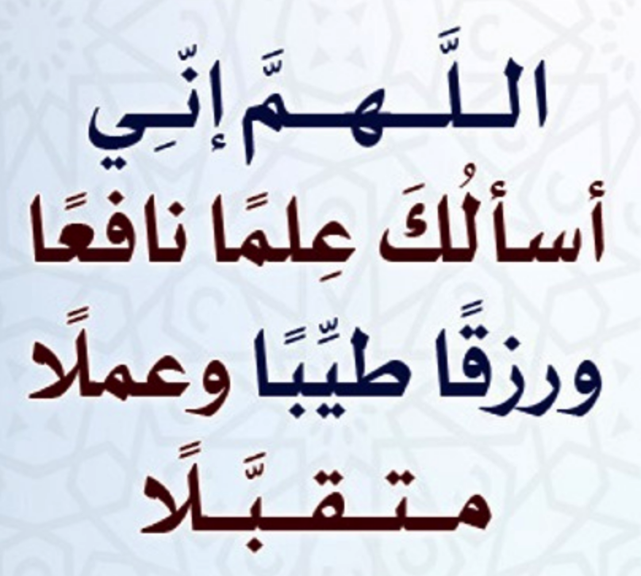
بِسْمِ اللّٰهِ الرَّحْمٰنِ الرَّحِيْمِ

Slide 2
Dialog

Slide 3
Mobile Computing
Mobile Computing
LECTURE
Dialog
Instructor:
Maulana Haq Nawaz

Slide 4
تصحیح نیت
حضرت محمد صلی اللہ علیہ وسلم نے فرمایا
اِنَّمَا الْاَعْمَالُ بِالنِّـیَّاتِ
ترجمہ
اعمال کا دارومدار نیتوں پر ہے

Slide 5

Little Efforts Daily Will Make You the Greatest
To systematically learn and get excellence in any concept / subject
روز کا کام روز کریں
اک مہینے کا کھانا ایک دن میں نہیں کھایا جا سکتا، ایسے ہی ایک مہینے کا کام ایک دن میں نہیں ہو سکتا

Slide 6
Little Efforts Daily Will Make You the Greatest
Importance of completing tasks on daily basis
Main Reason of Failure in Life
یہ کام کل کریں گے
جو کام کبھی بھی ہو سکتا ہے وہ کبھی نہیں ہوتا
زندگی ایک دن ہے اور وہ ہے آج۔ زندگی میں کل نام کی کوئی چیز نہیں ہے
جو دن آپ کی زندگی سے چلا گیا اب واپس نہیں آئے گا
آج کا کام آج ہی ہوسکتا ہے
جو گز گیا وہ آنا نہیں ، آنے والے دن کا پتہ نہیں ، آج میدان جما ہے تو اپنے جوہر دکھاؤ

Slide 7
How to Achieve BIG Goals in Life
Balanced Life is Ideal Life 😊
To achieve BIG Goals in Life
Make a Schedule of 24 Hours with a focus on Five main components of Human Life
Health
Physical Health
Mental Health
Social Health
Spirituality
Work
Family
Friends

Slide 8



جو کام کریں دل سے کریں
کام کرنا.
خوشی خوشی کام کرنا.
الله کو ساتھ لے کرخوشی خوشی کام کرنا.
آیت: إِيَّاكَ نَعْبُدُ وإِيَّاكَ نَسْتَعِينُ
ترجمہ: یا الله ہم تیری ہی عبادت کرتے ہیں.
اور تجھ ہی سے مد د مانگتے ہیں

Slide 9
Lecture Outline
1
Revision
2
Dialog Overview
3
Alert Dialog
4
Alert Dialog with Multiple Choices
5
Customize Alerts
6
Stop Complaining! Stop Criticizing! Let’s Start Contributing
7
Lecture Summary

Slide 10
Perfection and Neglection
قَدْ أَفْلَحَ الْمُؤْمِنُونَ الَّذِينَ هُمْ فِي صَلَاتِهِمْ خَاشِعُونَ ﴿1-2 المؤمنون﴾
Success is really attained by the believers who concentrate their attention in humbleness when offering Salāh (prayers)
فَوَيْلٌ لِلْمُصَلِّينَ الَّذِينَ هُمْ عَنْ صَلَاتِهِمْ سَاهُونَ ﴿4-5 الماعون﴾
So, Woe to those performers of Salāh, who are neglectful of their Salāh, {Expression of sorrow on some event}
Notes:
Task is same results are entirely different reseaon اَرَءَیۡتَ الَّذِیۡ یُکَذِّبُ بِالدِّیۡنِ ؕ﴿۱﴾: Have you seen him who denies the Requital?
فَذٰلِکَ الَّذِیۡ یَدُعُّ الۡیَتِیۡمَ ۙ﴿۲﴾ So, he is the one who pushes away the orphan
وَ لَا یَحُضُّ عَلٰی طَعَامِ الۡمِسۡکِیۡنِ ؕ﴿۳﴾ And does not persuade (others) to feed the needy.
Perfection in time, perfection in offering,

Slide 11
Dialog
A dialog is a small window that prompts the user to make a decision or enter additional information. A dialog does not fill the screen and is normally used for modal events that require users to take an action before they can proceed.
Notes:
Toasts are not clickable. If user response to a status message is required, consider instead using a Notification.

Slide 12
Dialog
The Dialog class is the base class for dialogs, but you should avoid instantiating Dialog directly. Instead, use one of the following subclasses:
AlertDialog A dialog that can show a title, up to three buttons, a list of selectable items, or a custom layout.
DatePickerDialog or TimePickerDialog A dialog with a pre-defined UI that allows the user to select a date or time.
Notes:
Toasts are not clickable. If user response to a status message is required, consider instead using a Notification.

Slide 13
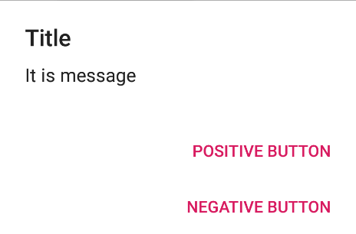
AlertDialog
Notes:
Toasts are not clickable. If user response to a status message is required, consider instead using a Notification.

Slide 14
AlertDialog
// Create the object of AlertDialog Builder class AlertDialog.Builder builder = new AlertDialog.Builder(MainActivity.this);
// Set the message show
builder.setMessage(”Message you want to show");
// Set Alert Title builder.setTitle("Alert !");
// Set Cancelable false for when the user clicks on the outside the Dialog Box then it will remain show builder.setCancelable(false);
Notes:
Toasts are not clickable. If user response to a status message is required, consider instead using a Notification.

Slide 15
AlertDialog
// Set the positive button with yes name OnClickListener method is use of DialogInterface interface. builder.setPositiveButton( "Kill", new DialogInterface.OnClickListener() { @Override public void onClick(DialogInterface dialog, int asdf) { // When the user click yes button then app will close finish(); } });
Notes:
Toasts are not clickable. If user response to a status message is required, consider instead using a Notification.

Slide 16
AlertDialog
public void showDialog(View view) { AlertDialog.Builder builder = new AlertDialog.Builder(MainActivity.this); builder.setMessage("It is message"); builder.setTitle("Title"); builder.setCancelable(false); builder.setPositiveButton( "Positive Button", new DialogInterface.OnClickListener() { @Override public void onClick(DialogInterface dialog, int asdf) { finish(); } }); builder.setNegativeButton( "Negative Button", new DialogInterface.OnClickListener() { @Override public void onClick(DialogInterface dialog, int which) { dialog.cancel(); } }); AlertDialog alertDialog = builder.create(); alertDialog.show(); } }
Notes:
Toasts are not clickable. If user response to a status message is required, consider instead using a Notification.

Slide 17
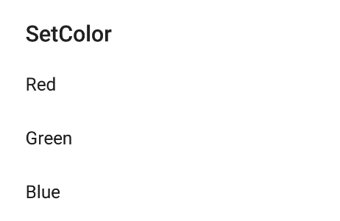
AlertDialog with List
Notes:
Toasts are not clickable. If user response to a status message is required, consider instead using a Notification.

Slide 18
AlertDialog with List
public class AlertDialogListActivity extends AppCompatActivity { String [] Colors = {"Red", "Green", "Blue"}; @Override protected void onCreate(Bundle savedInstanceState) { super.onCreate(savedInstanceState); setContentView(R.layout.activity_alert_dialog_list); AlertDialog.Builder builder = new AlertDialog.Builder(this); builder.setTitle("SetColor") .setItems(Colors, new DialogInterface.OnClickListener() { public void onClick(DialogInterface dialog, int which) { Toast.makeText(AlertDialogListActivity.this, Colors[which], Toast.LENGTH_SHORT).show(); } }); AlertDialog dialog = builder.create(); dialog.show(); } }
Notes:
Toasts are not clickable. If user response to a status message is required, consider instead using a Notification.

Slide 19
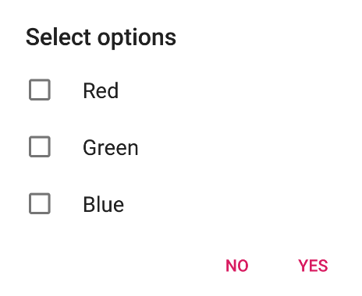
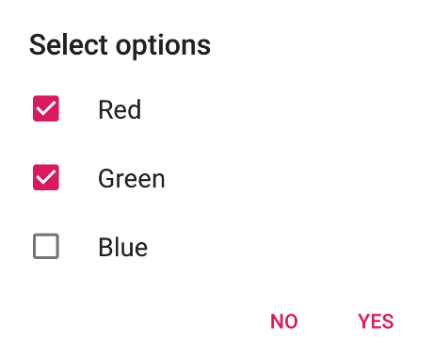
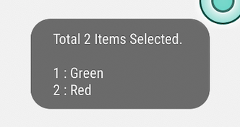
AlertDialog with Multiple Choice
Notes:
Toasts are not clickable. If user response to a status message is required, consider instead using a Notification.

Slide 20
AlertDialog with List
String [] Colors = {"Red", "Green", "Blue"}; ArrayList<Integer> selectedItems = new ArrayList(); // Where we track the selected items @Override protected void onCreate(Bundle savedInstanceState) { super.onCreate(savedInstanceState); setContentView(R.layout.activity_multiple_choice_dialog); AlertDialog.Builder builder = new AlertDialog.Builder(this); builder.setTitle("Select options") .setMultiChoiceItems(Colors, null, new DialogInterface.OnMultiChoiceClickListener() { @Override public void onClick(DialogInterface dialog, int which, boolean isChecked) { if (isChecked) { selectedItems.add(which); } else if (selectedItems.contains(which)) { selectedItems.remove(Integer.valueOf(which)); } } }) .setCancelable(false)
Notes:
Toasts are not clickable. If user response to a status message is required, consider instead using a Notification.

Slide 21
AlertDialog with List
.setPositiveButton("Yes", new DialogInterface.OnClickListener() { @Override public void onClick(DialogInterface dialog, int which) { String msg = ""; for (int i = 0; i < selectedItems.size(); i++) { msg = msg + "\n" + (i + 1) + " : " + Colors[ selectedItems.get(i)]; } Toast.makeText(getApplicationContext(), "Total " + selectedItems.size() + " Items Selected.\n" + msg, Toast.LENGTH_SHORT).show(); } }) .setNegativeButton("No", new DialogInterface.OnClickListener() { @Override public void onClick(DialogInterface dialog, int which) { Toast.makeText(MultipleChoiceDialogActivity.this,"No Option Selected",Toast.LENGTH_SHORT).show(); } }); AlertDialog dialog = builder.create(); dialog.show(); } }
Notes:
Toasts are not clickable. If user response to a status message is required, consider instead using a Notification.

Slide 22
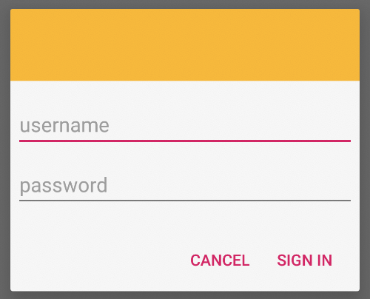
AlertDialog with Customize Layout
Notes:
Toasts are not clickable. If user response to a status message is required, consider instead using a Notification.

Slide 23
AlertDialog with List
@Override protected void onCreate(Bundle savedInstanceState) { super.onCreate(savedInstanceState); setContentView(R.layout.activity_sign_in_dialog); AlertDialog.Builder builder = new AlertDialog.Builder(this); LayoutInflater inflater = this.getLayoutInflater(); builder.setView(inflater.inflate(R.layout.sign_in, null)) // Add action buttons .setPositiveButton("Sign In", new DialogInterface.OnClickListener() { @Override public void onClick(DialogInterface dialog, int id) { // sign in the user ... } }) .setNegativeButton("Cancel", new DialogInterface.OnClickListener() { public void onClick(DialogInterface dialog, int id) { } }); AlertDialog dialog = builder.create(); dialog.show(); }
Notes:
Toasts are not clickable. If user response to a status message is required, consider instead using a Notification.

